Slide 1

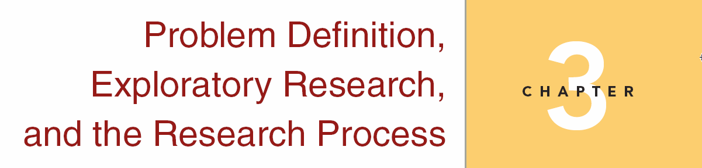
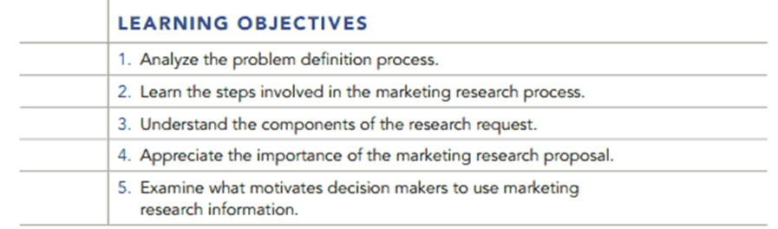
Chapter Three
3-1

Slide 2
Question
Critique the following methodologies and suggest more appropriate alternatives:
a. A supermarket is interested in determining its image. Cashiers drop a short questionnaire into the grocery bag of each customer prior to bagging the groceries.

Slide 3
Answer
This method has the advantage of potentially reaching all customers. However, the customer might not find the questionnaire in the bottom of the grocery bag. The customer also might not know how or when to return it if (s)he did find it.
A better alternative might be to hand each customer a questionnaire as he or she enters the store, provide a specific location to return it, and provide a coupon or other reward for completing the survey.
The store might also want to consider whether it is interested only in what customers think, or whether a better method might be to determine the opinions of the general population surrounding the store.

Slide 4
Question
b. To assess the extent of its trade area, a shopping mall stations interviewers in the parking lot every Monday and Friday evening. After people park their cars, interviewers walk up to them and ask them for their Zip codes.

Slide 5
Answer
One problem identified with this method is interviewing customers only on Monday and Friday evenings. How many different customers might be missed? Many people take shopping trips on weekends, particularly on Saturdays.
Also, many customers would be frightened, and then offended by being approached in the parking lot, particularly in the evening. This might also put the interviewers in danger. A better solution might be to station interviewers at the major entrances to the mall at different days and times throughout the week.

Slide 6
Question
c. To assess the potential for new horror movies starring alien robots, a major studio invites people to call a 900 number and vote yes if they would like to see such movies or no if they would not. Each caller was billed a $2 charge.

Slide 7
Answer
Your sample will probably not be representative of the target market. Only those with extreme feelings would call to answer this question. Many people would have an opinion, but will not be willing to pay $2 to voice it.
A better alternative might be to film short sequences that would be typical of the films in question, and then invite a random sample of people to view the film clip in a theater or a private room in a shopping mall. Those viewers could then be interviewed regarding their opinions.

Slide 8
Question
Read REAL-LIFE RESEARCH
Case 3.1- Let’s Go Out to Eat
Would you say that this was an exploratory study? If not, what are the research questions?
Is this research causal or descriptive? Why?
Explain how the Olive Garden might use this information; McDonald’s.

Slide 9
Answer
This is not an exploratory study. The research questions are how to up sell customers in a restaurant and how to provide exceptional service to increase sales.
This is a descriptive study. It describes the experiences of customers and contact personnel in a restaurant environment.

Slide 10
Answer
3. Olive garden can have servers suggest higher priced menu items to customers as well as appetizers, desserts and mixed drinks. Mc Donald’s can use this information to train their drive up window personnel to cross sell hamburgers and French fries.

Slide 11
Question
____________ is preliminary research conducted to increase the understanding of a concept, to clarify the exact nature of the problem to be solved, or to identify important variables to be studied.
Pilot study
Experience survey
Case analysis
Exploratory research
Situation analysis

Slide 12
Answer
Ans: D

Slide 13
Question
A/An _______________ is a survey using a limited number of respondents and often employing less rigorous sampling techniques than are employed in large quantitative studies.
a. pilot study
b. experience survey
c. case analysis
d. situation analysis
e. none of these
Ans: A

Slide 14
Question
A/An _______________ is a survey using a limited number of respondents and often employing less rigorous sampling techniques than are employed in large quantitative studies.
a. pilot study
b. experience survey
c. case analysis
d. situation analysis
e. none of these

Slide 15
Answer
Ans: A

Slide 16
Question
What does the iceberg principle refer to?
Most data analysis techniques tend to be outdated.
Research objectives are not often clearly defined.
Symptoms are often mistaken for problems in business.
none of these

Slide 17
Answer
Ans: B

Slide 18
Question
“We believe that raising the price of membership of our country club will make it more desirable, and will increase our membership base” is an example of a(n) _______.
objective
management problem
hypothesis
marketing research problem
none of these

Slide 19
Answer
Ans: C

Slide 20
Question
To test the effectiveness of changes in an advertising campaign, a marketing research firm decides to implement certain changes in Atlanta, other changes in Dallas, and no change to the ad campaign in Denver. With regard to the products in question, the purchasing propensities in the three cities are equal. What type of research design is the marketing research firm invoking?
exploratory study design
observational study design
descriptive study design
causal study design
all of these

Slide 21
Answer
Ans: D

Slide 22
Question
The researcher cannot compute the statistical reliability of this type of sample.
probability sample
experimental sample
nonprobability sample
observational sample
all of these

Slide 23
Answer
Ans: C

Slide 24
Question
In analyzing the effects of shelf placement on sales, shelf placement of the product is the _______.
a. independent variable
b. dependent variable
c. spurious variable
d. temporal variable
e. none of these

Slide 25
Answer
Ans: A

Slide 26
Question
In depth discussions, usually consisting of 8-12 participants, led by a moderator and generally limited to one particular concept, idea or them are:
a. Study groups
b. Accuracy groups
c. Focus groups
d. Case groups

Slide 27
Answer
Ans: C

Slide 28
Question
A firm is experiencing a 15% sales decline over the past year. The firm contracts with a marketing research firm to survey its customers to determine why sales are declining. Suggest how the principals in the marketing research firm should respond to their client’s demands.

Slide 29
Answer
The researchers should explain that declining sales are not the problem, and that an exploratory research effort preceding a survey will be necessary to clarify exactly what the problem might be. After the exploratory effort, clear research objectives can be established, and a more formal process can proceed.

Slide 30
Question
Describe the (3) three types of basic methods of research. Which ones would be used for descriptive research or causal research? Why?

Slide 31
Answer
Ans: Surveys, Observations, and Experiments, the textbook lists multiple characteristics of each type. Surveys and observations are usually used for descriptive research, and experiments and sometimes surveys are used for causal.

